Slide 1

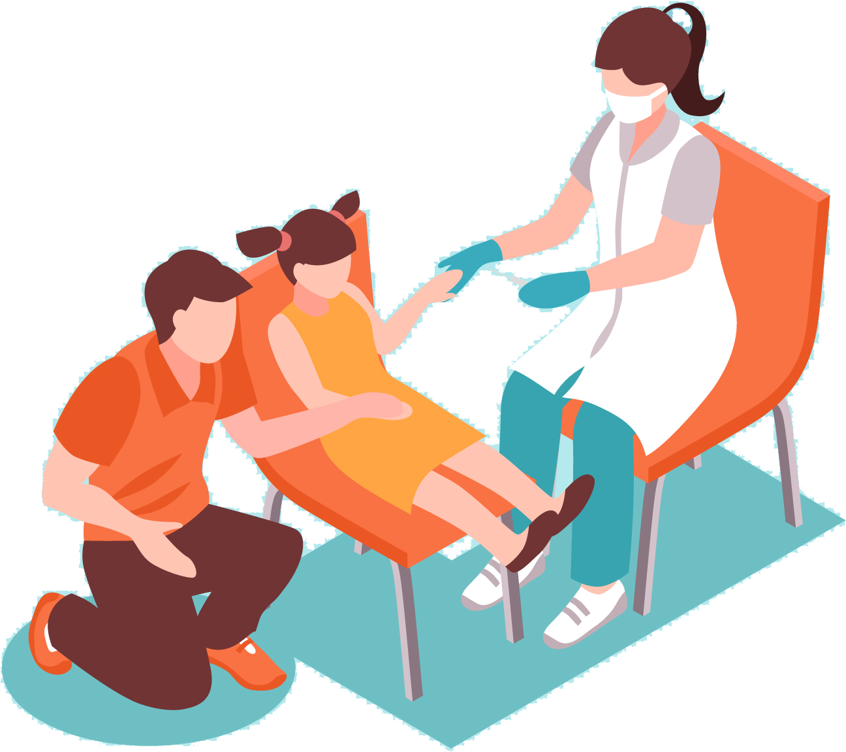

Diabetes Risk Predictor:
Applying Health Indicators for Early Detection

Slide 2
Table of Content
Introduction
Objectives
Data Understanding
Business Understanding
Model Evaluation
Results
Conclusion

Slide 3
Introduction
Diabetes is among the most prevalent chronic diseases in the United States, impacting millions of Americans each year and exerting a significant financial burden on the economy. Diabetes is a serious chronic disease in which individuals lose the ability to effectively regulate levels of glucose in the blood, and can lead to reduced quality of life and life expectancy

Slide 4

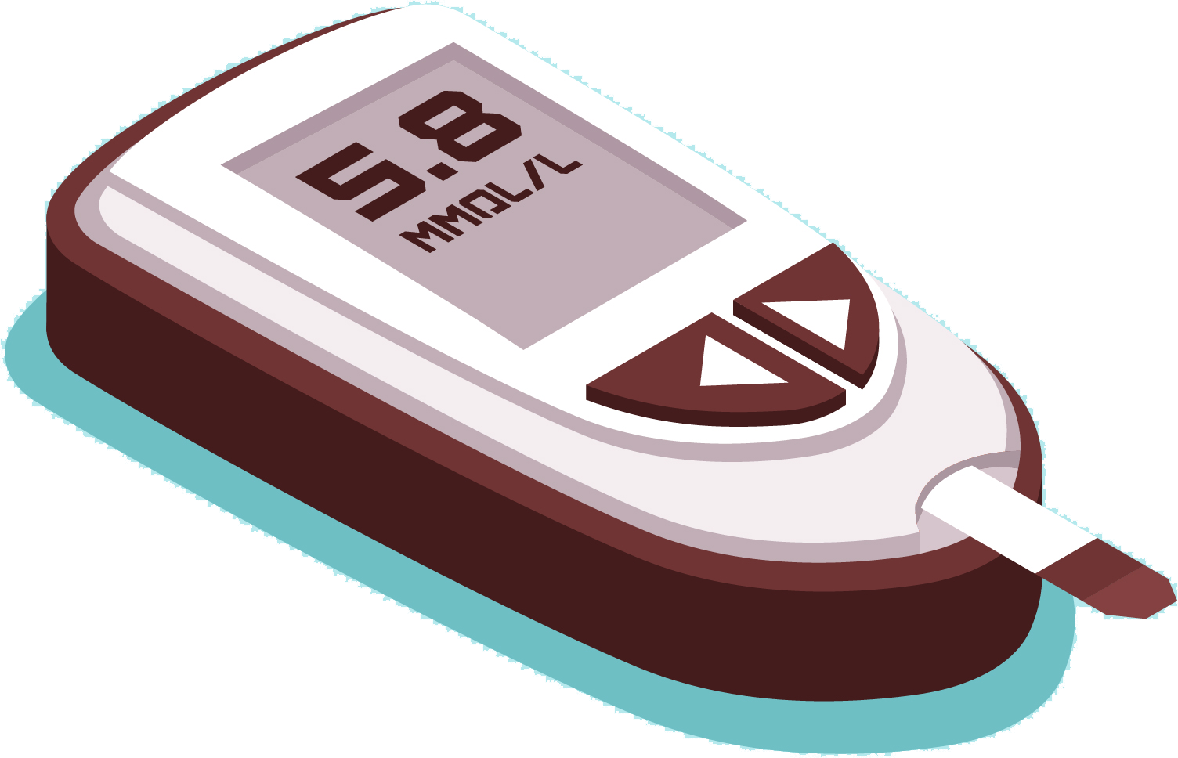
Objectives
Create a model that would be used to:
Identify individuals at risk for diabetes .
To identify individuals at high risk of developing diabetes before symptoms appear.
To tailor treatment and management plans based on individual risk profiles..
To enhance public health strategies and policies by identifying trends and risk factors.
To lower the long-term costs associated with diabetes management and complications.

Slide 5
Data Understanding
The "diabetes_binary_health_indicators_BRFSS2015.csv" file is a clean dataset of 253,680 survey responses to the CDC's BRFSS2015. The target variable is Diabetes_binary, which has 2 classes. 0 is for no diabetes, and 1 is for prediabetes or diabetes. This dataset has 21 feature variables and is not balanced.

Slide 6
Business Understanding
The dataset contains health indicators from the Behavioral Risk Factor Surveillance System (BRFSS) 2015, with a binary outcome indicating whether a patient has diabetes. The goal is to develop a predictive model that can accurately classify whether a patient has diabetes based on various health indicators.

Slide 7
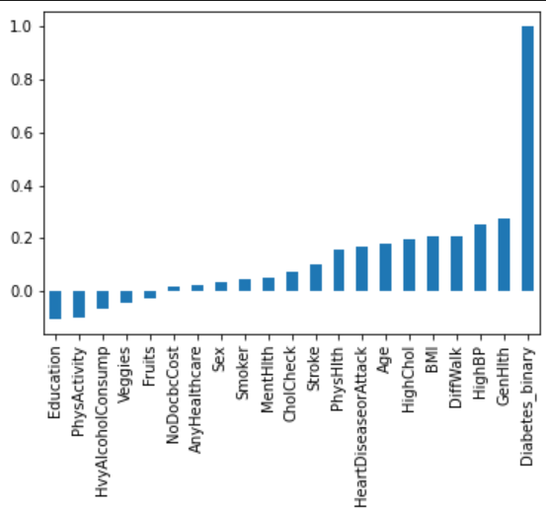
Factors to consider

Slide 8
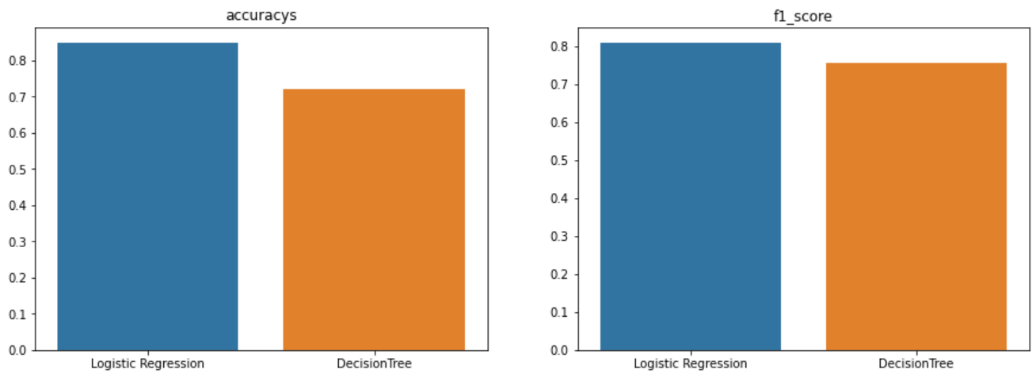
ModelEvaluation

Slide 9
Results
F1 score and accuracy of the Logistic Regression model is better compared to the Decision Tree model, making it the better model to use in the Dibetes Risk Prediction

Slide 10
Conclusion
The preferred model(Logistic) achieved an accuracy of 84%. It shows higher precision for non-diabetic class. Further improvements can be made by exploring more features or using advanced models.

